Slide 1
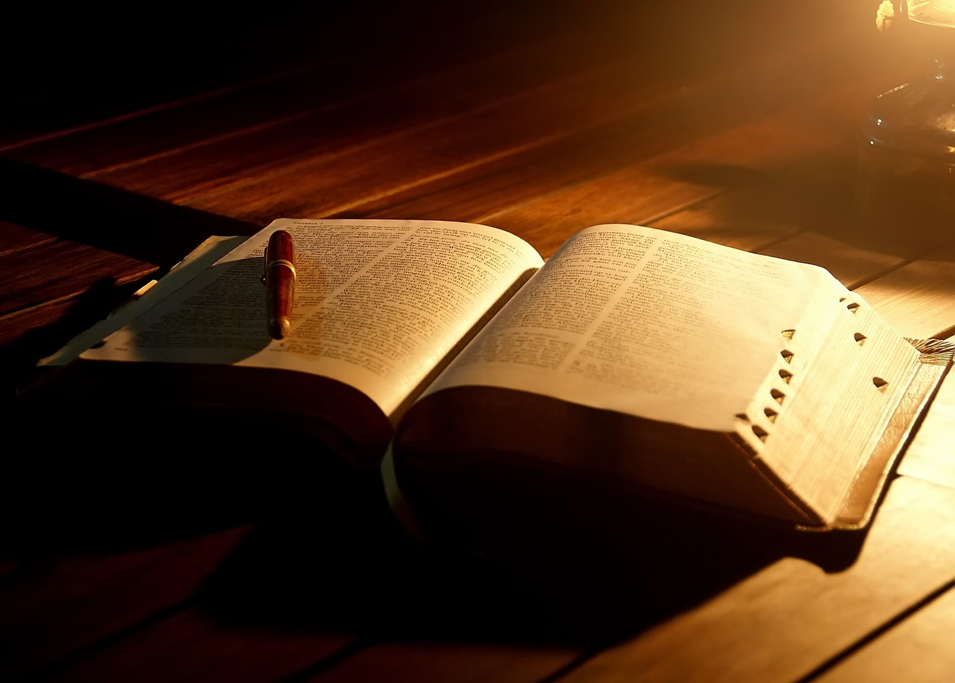
Finishing Well
Ecclesiastes 12:8-14
Dr. Rick Griffith • Crossroads International Church Singapore
CICFamily.com • BibleStudyDownloads.org

Slide 2

Last Words
Notes:
Today I want to take us all down a road—your future road to the last words that you will utter in this life. People's last words are significant as they reveal a lot about the life of those who spoke them—whether a life of regret or hope.

Slide 3

Last Words
Notes:
Just listen to some last words spoken by well-known Christians…

Slide 4
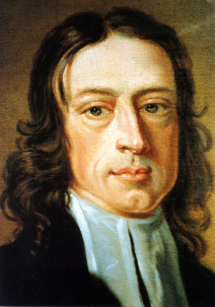
John Wesley's Last Words
"The best of all is, God is with us. Farewell! Farewell!"
Notes:
The founder of Methodism, John Wesley's last words were…

Slide 5
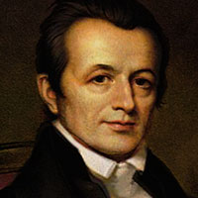
Adoniram Judson's Last Words
"I am not tired of my work, neither am I tired of the world; yet when Christ calls me home, I shall go with the gladness of a boy bounding away from school."
Notes:
Adoniram Judson, America's first missionary who gave his life to Burma, said at his deathbed…

Slide 6
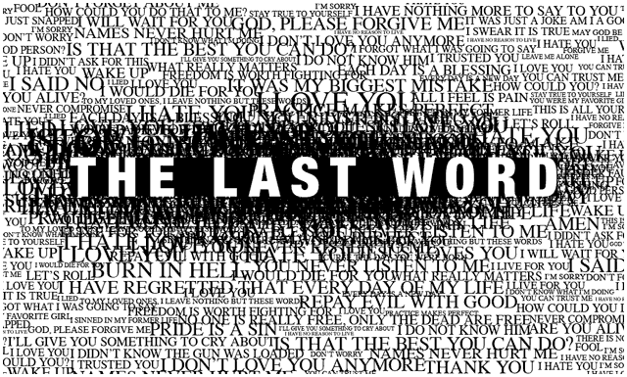
Last Words
Notes:
Contrast these with the final moments of some who rejected Christ…

Slide 7
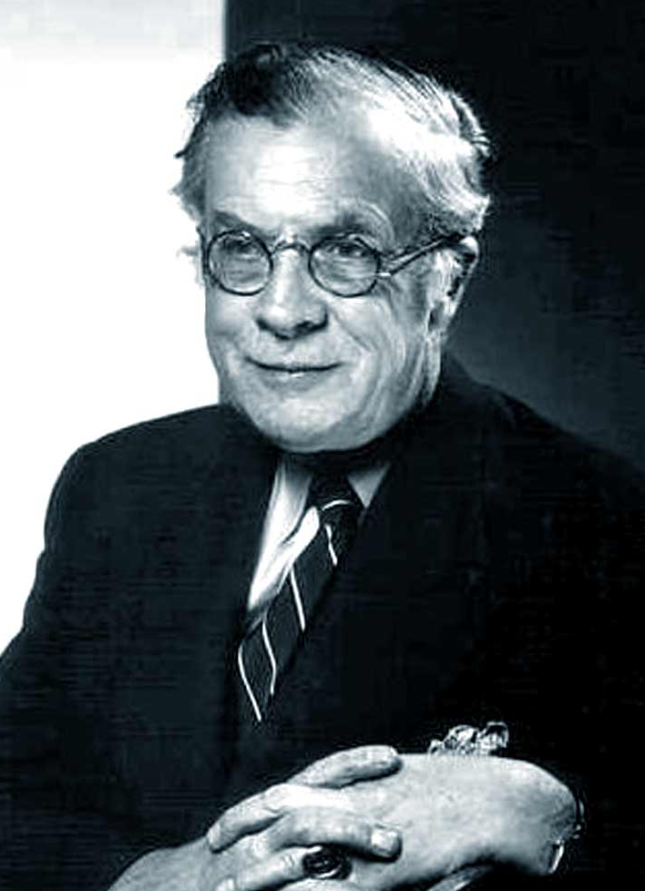
J. H. Huxley's Last Words
"So it is true."
Notes:
As the godless professor J. H. Huxley lay dying, the great skeptic suddenly looked up at some sight invisible to human eyes, and, staring a while, whispered at last, "So it is true." Then he died.

Slide 8
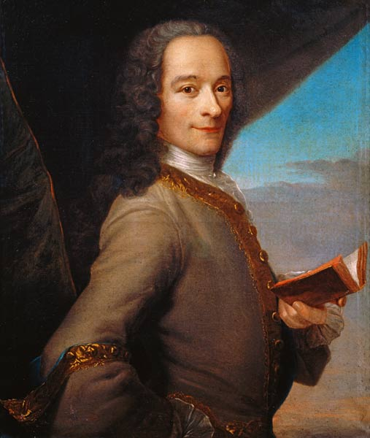
Voltaire's Last Words
"I am abandoned by God and man. I will give you half of what I am worth, if you will give me six months' life." The doctor replied, "Sir, you cannot live six weeks." Voltaire retorted, "Then I shall go to hell, and you with me."
Notes:
On his deathbed, the atheist Voltaire told his doctor…

Slide 9
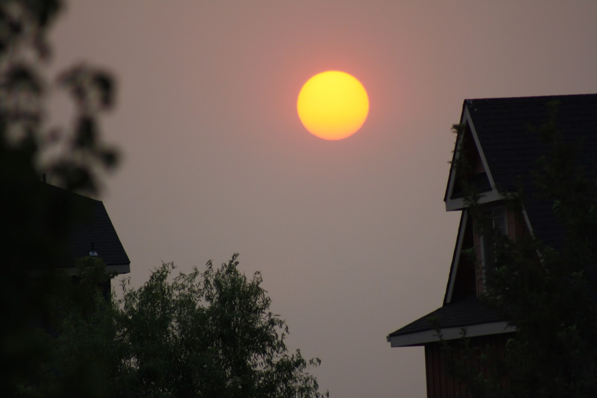
Live now in light of your end.

Slide 10

How can you finish well?

Slide 11
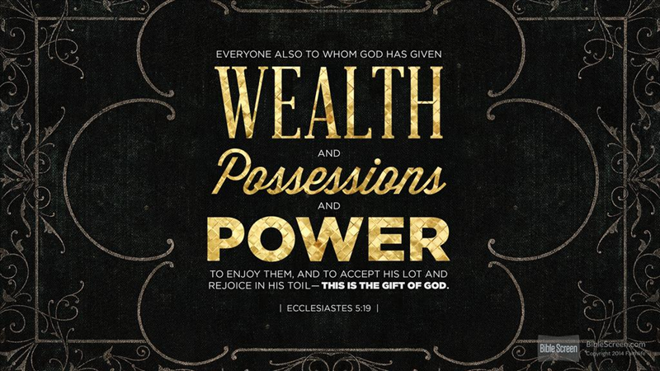
Solomon's Pursuits
Notes:
To explain true success, I can think of no better source than the most successful man who ever lived—at least in the world's eyes. What were his last words?
He was the richest man who ever lived.
He was also the smartest man ever.
So today let's heed the last words of a man who had experienced far more in life than any of us could ever dream.

Slide 12
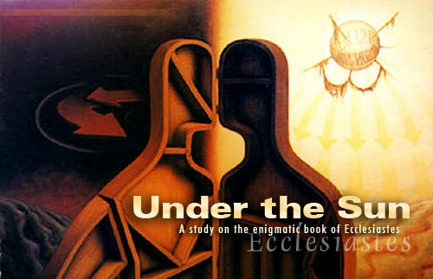
Cover
Under the Sun
A Study of the Book of Ecclesiastes
Notes:
You may have guessed I'm talking about King Solomon. He wrote the book of Ecclesiastes at the end of his life—so it gives his last words to us. Today we'll look at the last verses of the last chapter of his last book to see the lasting secret of lasting success.

Slide 13

Ecclesiastes 12:8-14
Last Words to Finish Well
Notes:
Today we'll zero in on his last words in Ecclesiastes 12:8-14.
These final seven verses conclude the book by citing three things: the theme, the authority of the book, and the way to true success.
Verse 8 repeats the theme of the entire book, that…

Slide 14

I. The Theme: Life is fleeting (12:8).
"Everything is meaningless,"
says the Teacher,
"completely meaningless."
Key Word of Ecclesiastes

Slide 15
Hebel literally means
"a breath, wind, or vapor"
(Prov. 21:6; Isa. 57:13).
Key Word of Ecclesiastes

Slide 16
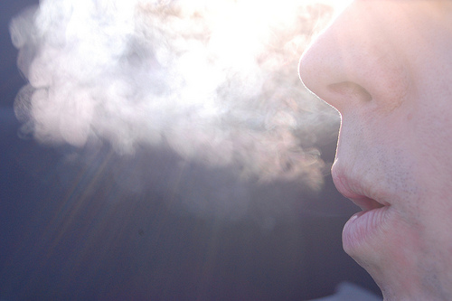
A Very Literal Translation
Metaphor:
what doesn't last ("what is without real substance, value, permanence, significance, or meaning" BKC, 1:976)

Slide 17


Meaning of Hebel
lbh
"vanity" (KJV, ESV, NAU), "meaningless" (NIV, NLT), "futile" (NET, TLB, BKC)
"fleeting"
Ecclesiastes

Slide 18
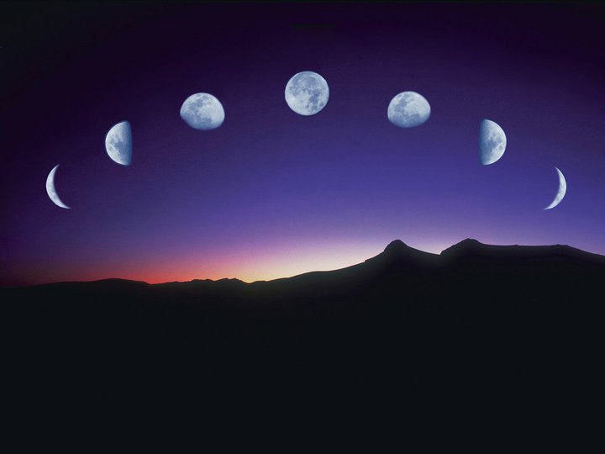
Our Study in Ecclesiastes
Work & Wisdom Don't Last

Slide 19
I. The Theme: Life is fleeting (12:8).
"Everything is meaningless,"
says the Teacher,
"completely meaningless."
Key Word of Ecclesiastes
Notes:
Sounds dismal, doesn't it? Maybe you're saying, "Can't you offer anything more positive than this today? If all human wisdom has no value then what value is there in listening to Solomon—or you, for that matter?" Good question. Actually, I have nothing of value to say today except what God says, and He says in verses 9-12 that his word is…

Slide 20
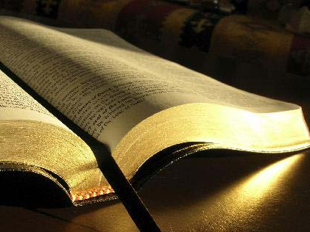
II. The Authority: Live by God's words (12:9-12).

Slide 21

God's Word pierces through!

Slide 22

God's words matter!
78
^{"9}Not only was the Teacher wise, but also he imparted knowledge to the people. He pondered and searched out and set in order many proverbs. ¹⁰The Teacher searched to find just the right words, and what he wrote was upright and true" (Eccl. 12:9-10 NIV).
Notes:
Solomon put his wisdom to work by teaching (12:9-10).
Solomon was a wise man who taught others knowledge (12:9a).
Solomon taught with proverbs (12:9b-d).
Some proverbs he thought up himself (12:9b).
Some proverbs he got from others (12:9c).
Some proverbs he arranged together [in the book of Proverbs?] (12:9d).
Solomon taught with the best words (12:10).
He used words that were aesthetically pleasing (12:10a).
He wrote with precision to guard the truth (12:10b).

Slide 23
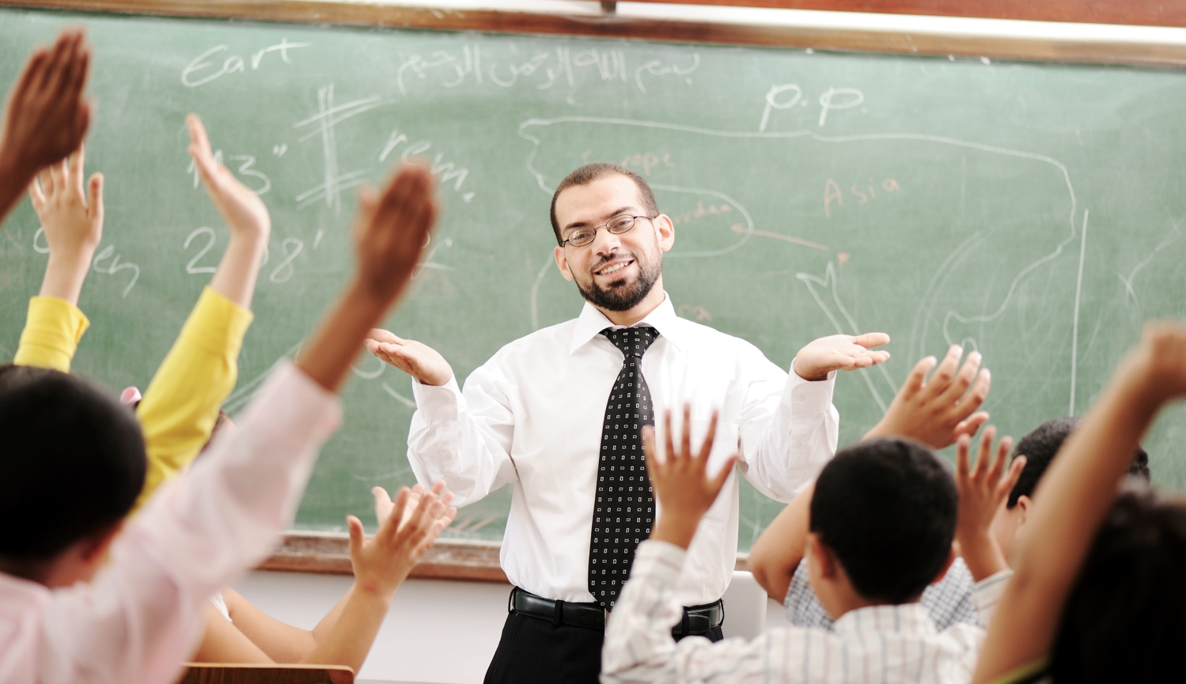
Your teachers have taught you with the wisest words they know.
Notes:
Can you think of any of their proverbs?
My best teacher used to say, "If you can read, you can cook!" Who? Mom!
Don't let their proverbs escape you. Write them down now so you won't forget them.

Slide 24
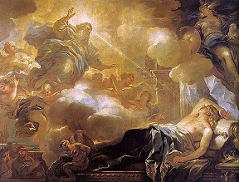
Scripture gives wisdom but non-inspired books have no ultimate answers and only wear us out (12:11-12)

Slide 25
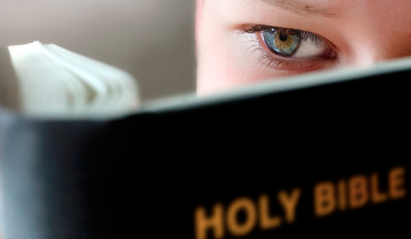
But how does the Bible's teaching through wise men give true wisdom (12:11)?

Slide 26
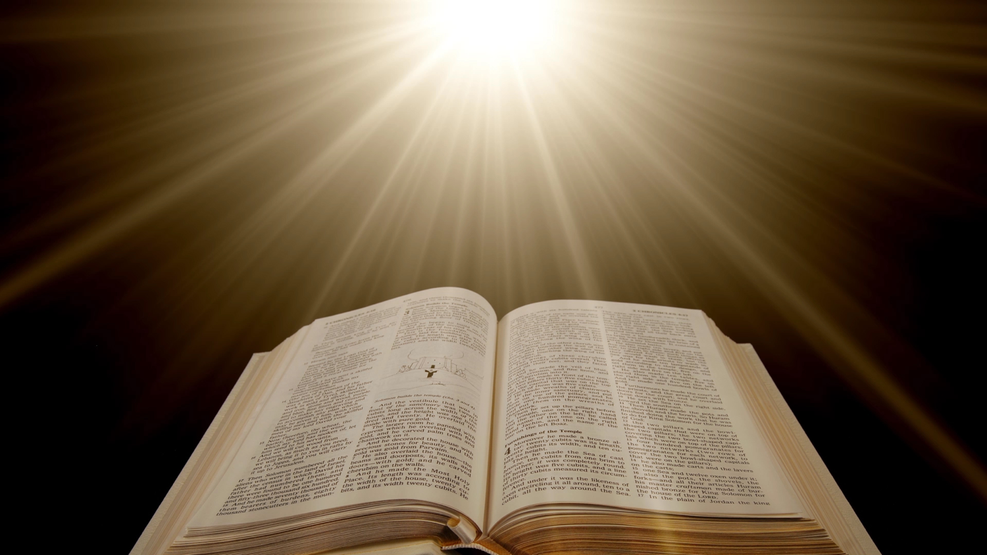
The Bible's Wisdom
78
^{"11}The words of the wise are like goads, their collected sayings like firmly embedded nails—given by one Shepherd. ¹²Be warned, my son, of anything in addition to them.
Of making many books there is no end, and much study wearies the body"
(Eccl. 12:11-12 NIV).

Slide 27
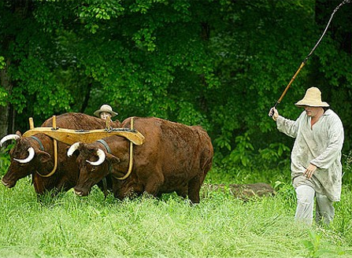
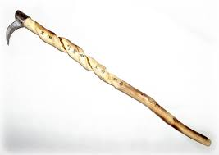
The Bible motivates and guides in wise living
78
^{"11}The words of the wise are like goads"
(Eccl. 12:11a NIV).

Slide 28
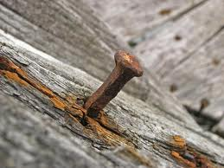
The Bible gives a strong basis for wise living
78
^{"11}…their collected sayings like firmly embedded nails"
(Eccl. 12:11b NIV).
Notes:
Years ago our 5-year-old, John, ran around the corner in our house and almost hit our 8-year-old, Stephen, who was carrying food to the table.
So I interviewed John: "Can you tell me why we don't run in the house?" "Because it can hurt people and break things," John responded.
When we all sat down to eat a few minutes later, John announced to the family, "I have good news and bad news. The good news is what is right, is right! The bad news is what is wrong, is wrong!"
We all laughed, but the realization hit us that much of what the world calls "wrong" is right and much of what the world calls "right" is wrong.
(But how can we tell the difference between right and wrong? God has to tell us, and…)

Slide 29
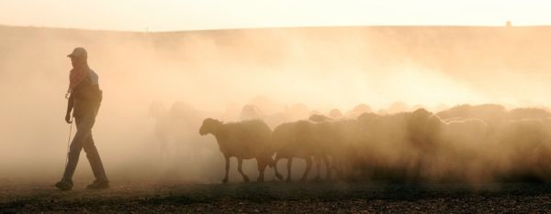
The Bible is the only Book that is divinely inspired
78
^{"11}…given by one Shepherd"
(Eccl. 12:11c NIV).

Slide 30
The Bible's Wisdom
78
^{"11}The words of the wise are like goads, their collected sayings like firmly embedded nails—given by one Shepherd. ¹²Be warned, my son, of anything in addition to them."
(Eccl. 12:11-12a NIV).
Notes:
In contrast, man's books provide no ultimate answers and wear us out (12:12).
Don't rely on books other than words of the wise (12:12a).

Slide 31

"Of making many books there is no end…"
(Eccl. 12:12b NIV)
Notes:
Man's many books still have not answered our most vital questions (12:12b).

Slide 32

"…and much study wears you out"
(12:12c NLT).

Slide 33
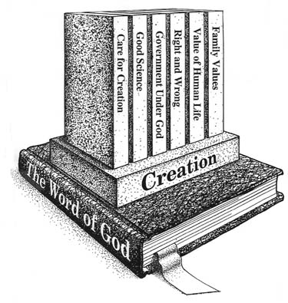
Get a Biblical Foundation
Notes:
Every one of us is headed towards more learning throughout our lives—and towards being wearied by a lot more study and books!
How can you survive all the books and study yet ahead?
Make the Book you study most be the only one that genuinely refreshes!
Sure, study other books, but make this Book the one you read every day, OK?

Slide 34
I. The Theme: Life is fleeting (12:8).
"Everything is meaningless,"
says the Teacher,
"completely meaningless."
Key Word of Ecclesiastes

Slide 35
II. The Authority: Live by God's words (12:9-12).
Notes:
Since only Scripture has ultimate value for us, the best thing we can do in life is to respect the Author and live in light of His plan. In fact, this is just what the conclusion tells us…

Slide 36

III. The Conclusion: Respect and obey God because this applies to everyone
(12:13-14 ).
Notes:
Live in awe of God and do what He says so that you'll always be doing the right thing.

Slide 37
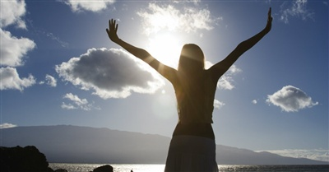
"That's the whole story.
Here now is my final conclusion:
Fear God and obey his commands"
(12:13a-b NLT).
Notes:
You'll succeed when you respect God's person (13a).
Fearing Him means living aware of his awesome love for you!

Slide 38
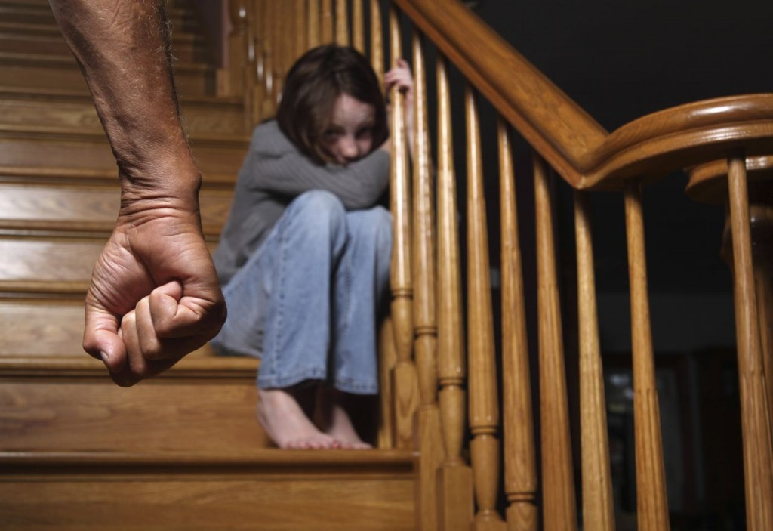
"Fear God"? No.
Notes:
Does this mean we cower before God as if he's going to hit us? No.

Slide 39
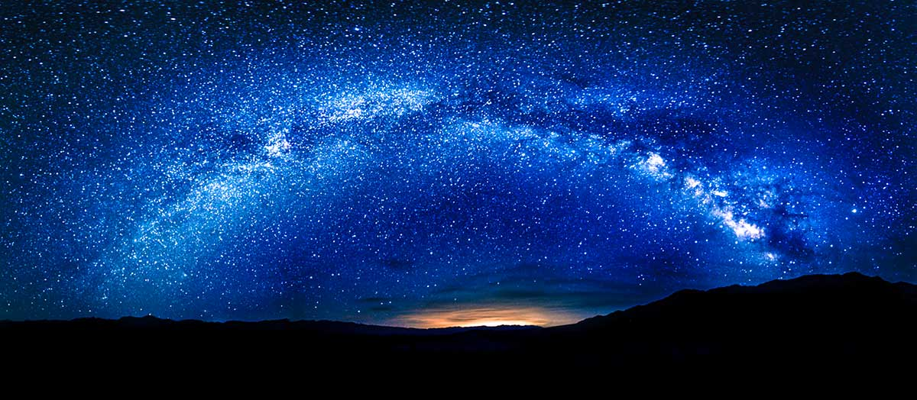
"Fear God"! Yes!
Notes:
Fearing Him means living aware of his awesome love for you!

Slide 40

"Remember your Creator in the days of your youth" (12:1)

Slide 41

Enjoy life but honor God (11:7–12:7)

Slide 42

The way to enjoy your youth is to honor God
Main Idea of (11:7–12:7)

Slide 43
"That's the whole story.
Here now is my final conclusion:
Fear God and obey his commands"
(12:13a-b NLT).
But why?
Notes:
You'll succeed when you respect God's person (13a).
Fearing Him means living aware of his awesome love for you!
You'll also succeed when you follow God's standards (13b). Do what He says!
Realize that he gives us commands to live by because he has your best interest in mind

Slide 44
"That's the whole story. Here now is my final conclusion: Fear God and obey his commands, for this is everyone's duty"
(12:13 NLT).
Notes:
Respecting and obeying God is the main task for which we'll be accountable (13c-14).
Respect and obey God as it ensures you'll do everything else that's important (13c).

Slide 45
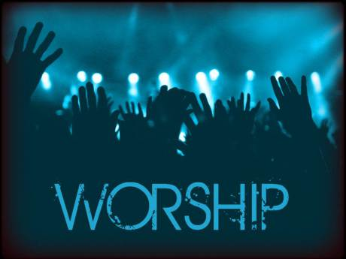
Worship
Notes:
Worship is one of the very few things we do on earth that we will do in heaven.

Slide 46

Awe!
Notes:
What a tragedy that I have discovered in Singapore that most churches have two thirds of their people show up late for worship! They don't seem to have a problem getting to work on time. I suspect that most would be on time to have an appointment with the Prime Minister, but to do so for God is much harder—even though God is far greater!

Slide 47
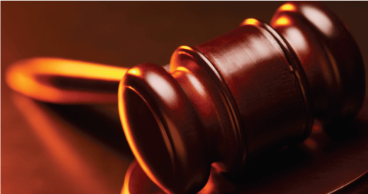
"God will judge us for everything we do, including every secret thing, whether good or bad" (12:14 NLT).
Notes:
Respect and obey God because you'll account to Him for every good and bad act (14).

Slide 48
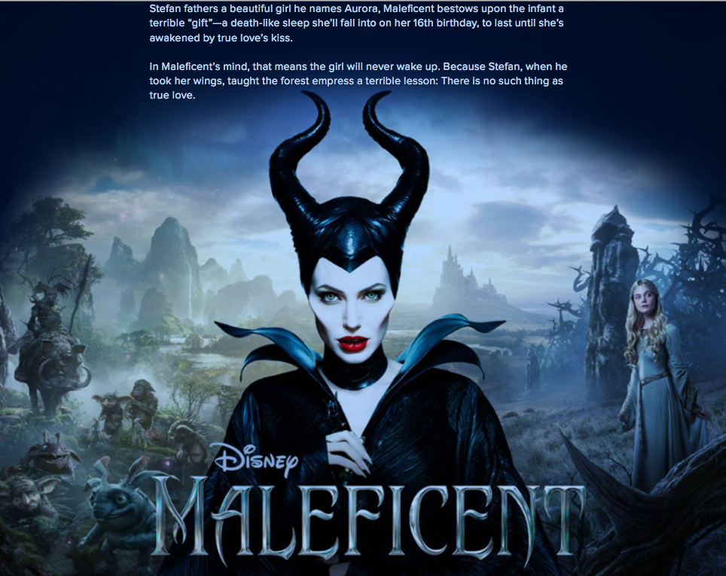
Maleficent
Notes:
The 2014 movie Maleficent portrays a frightening ruler of an evil realm.

Slide 49

Maleficent
Notes:
She is called Maleficent and has great power but is betrayed.

Slide 50
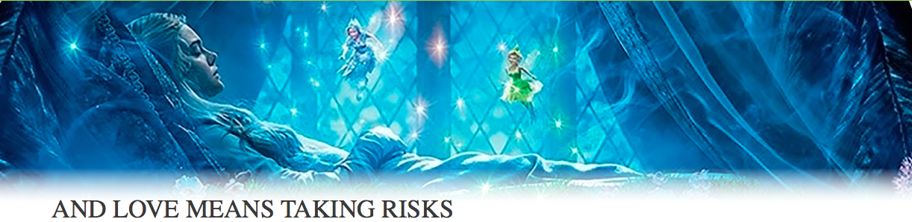
Maleficent
Notes:
In revenge she causes a little girl to become a "Sleeping Beauty." Enter the typical love story of this little girl who grows up and wins over the heart of evil Maleficent—

Slide 51
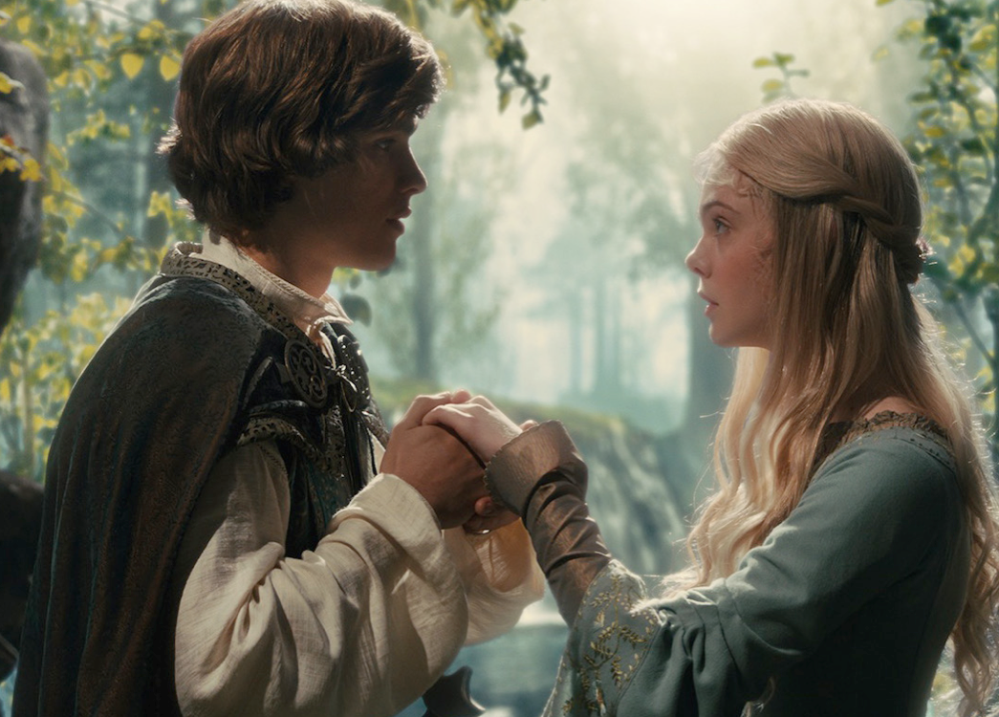
Maleficent
Notes:
as well as that of her own Prince Charming.

Slide 52
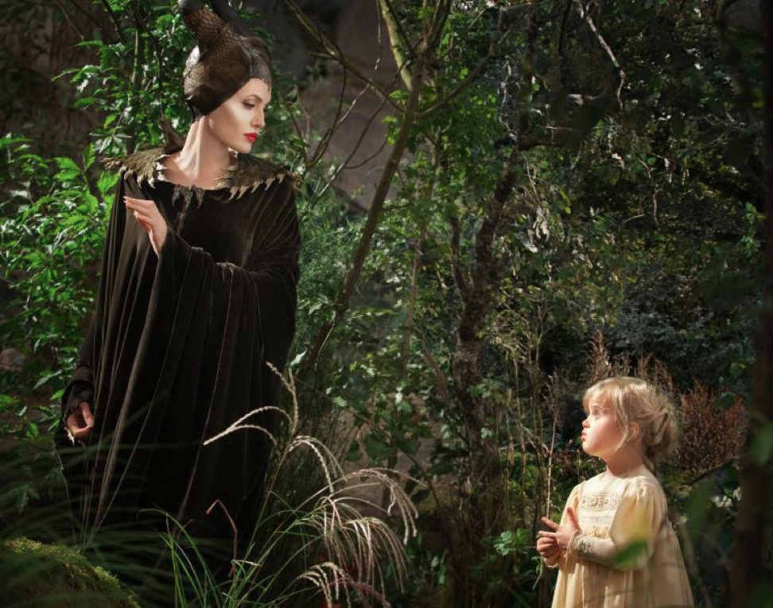
Maleficent
Notes:
One key scene of the movie was difficult to shoot, though.
The movie critics, Plugged In notes, "Note that it's Jolie's daughter, Vivienne, who plays the 5-year- old Aurora—waddling over to Maleficent and saying, 'Up, up!' Maleficent dutifully picks the girl up, and the young Aurora plays with the witch's fearsome horns—the beginning, it would seem, of Maleficent's softening stance...
"Jolie later told Entertainment Weekly that they originally tried to get other girls to play the young Aurora, but they were terrified of Jolie's makeup and outfit. 'It had to be a child that liked me and wasn't afraid of my horns and my eyes and my claws,' Jolie said. 'So it had to be Viv.'"

Slide 53
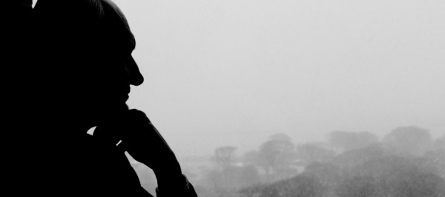
How do you approach God?
Notes:
When I read this, I thought. Hmmm, how like us approaching God. He seems terrifying to those who do not know him as they will give an account of their lives to him. However, to those of us who place childlike faith in him, he is not a frightening God but rather a loving Father, worthy of our respect.

Slide 54
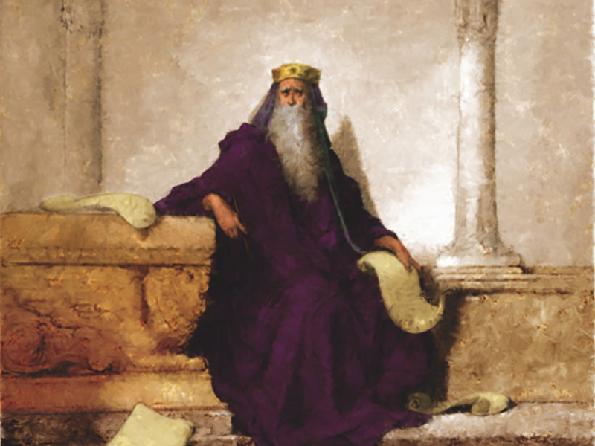
So what does the wisest, wealthiest, most successful man in human history tell us in his last words?

Slide 55
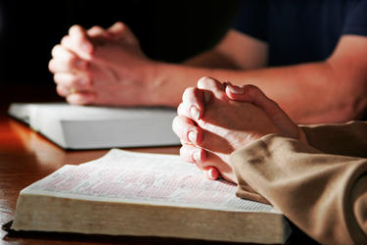
Solomon's Key Idea
Respect and obey God
to finish well.

Slide 56

Worldly Advice
Notes:
The key to success is not to respect yourself—it is to honor God!

Slide 57

Are you hungry?
Notes:
Do you give priority more to Scripture or to learning from other sources—TV, social media, movies, magazines, newspapers, secular books, even Christian books?

Slide 58

"How can you tell a 1st year seminary student from a 4th year?"
1st Year
4th Year
?
"All zeal,
no knowledge"
"All knowledge,
no zeal"
Notes:
During my first year of seminary, a graduating student asked me, "Do you know how to tell the difference between a first year and a fourth year student?" I confessed I didn't. He said, "First year men are all zeal, no knowledge. Fourth year men are all knowledge, no zeal."
And then came SMF chapel's slide show where guys spotted a man reading by the campus fountain. "Hey, he's reading his Bible!' they said. "Must be a first year student!" Everyone laughed, but I thought how much I wanted to make sure my heart for the Word didn't dissipate during seminary.

Slide 59

Your Pursuit?
Notes:
You may need to read other books more than this Book, but may I encourage you to read this Book first? Make it your daily habit to get God's view on life before you get any other!

Slide 60

Bible Reading Plans
5 min./day = 1/288th of a day
bible-reading.com
Notes:
Are you willing to tell God even right now that you'll read this Book at least 5 minutes daily—for the rest of your life?
In 1977 I committed to reading the Bible at least 5 minutes a day—but that's only 1/12th of an hour and 1/288th of a day! Not really a big decision…
If you won't make a commitment even this small, then I can offer little hope that you will be successful in what really counts in life.
But if you will commit to allow His words to change you daily, you will be making one of the best decisions possible.

Slide 61
Black
Notes:
Will you finish well? What will your last words be? May they reflect that you understood what it means to "Fear God and keep his commandments."
Prayer

Slide 62


OT Preaching link at BibleStudyDownloads.org
Get this presentation and script for free!

